Slide 1
Normalization and K-fold Cross-Validation example
02/23/24

Slide 2
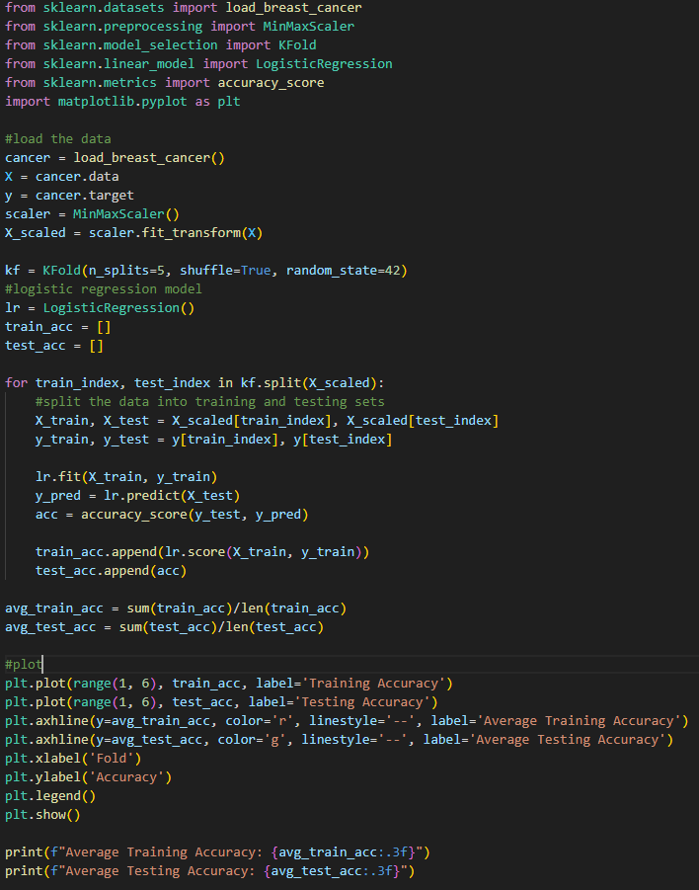
The breast cancer dataset is loaded, and the features and target are extracted. The MinMaxScaler is then used to scale the features to a range of 0 to 1.
In the K-Fold Cross-Validation code, the K-Fold cross-Validation is initialized with 5 folds, shuffled, and a random state is set. The logistic regression model is initialized, and lists are created to store the training and testing accuracy.
The code then loops through the folds, splitting the data into training and testing sets for each fold. The model is trained on the training set and evaluated on the testing set using the predict() method and the accuracy_score() function from sklearn.metrics. The training and testing accuracy for each fold is stored in the lists.
Finally, the average training and testing accuracy for all folds is computed.

Slide 3

Relevancy: Data normalization is used to transform the features of the dataset to have the same scale. By normalizing the features, we can ensure that each feature has equal weight in the model and prevent any feature from dominating the model due to its scale.
K-Fold Cross-Validation is used to evaluate the performance of the logistic regression model. By splitting the dataset into multiple folds and training and testing the model on each fold, we can ensure that the model is not overfitting or underfitting the data.
Suggests that the logistic regression model is performing well on the breast cancer dataset. The high accuracy indicates that the model is able to accurately classify the majority of the samples in both the training and testing sets.
But it is important to note that accuracy is not always the best metric to evaluate the performance of a model, especially if the dataset is imbalanced or if the cost of misclassifying different classes is not equal.

